Slide 1
SEDS Review
Liquid Fuels Sector
May 7, 2009
Don Hanson
Deena Patel
Argonne National Laboratory

Slide 2
Liquid Fuels Sector in Context of SEDS
Macroeconomics
Primary Energy
Converted Energy
End-Use
Biomass
Biofuels
Buildings
Coal
Electricity
Heavy Transportation
Macroeconomics
Natural Gas
Hydrogen
Industry
Oil
Liquid Fuels
Light Vehicles

Slide 3
Liquid Fuels Sector Data Flow
Incoming Data
Outgoing Data
Oil
Crude Oil Price
Oil Demand
Oil
Coal
Coal Demand
Coal
Coal Price
Natural Gas
Natural Gas Demand
Natural Gas
Natural Gas Price
Biofuels
Cellulosic Ethanol
Price and Capacity
Desired Cellulosic
Ethanol Capacity
Biofuels
Electricity
Liquid Fuels
Electricity Demand
Electricity
Electricity Price
Heavy Fuel Oil Price
Industry
Industry
Light Fuel Oil Price
Light Fuel Oil Demand
Buildings
Buildings
Diesel and Gasoline
Price
Heavy Duty Transportation
Fraction of Pure
Gasoline from Petroleum
Heavy Duty Transportation
Diesel and Gasoline
Demand
Fraction of Distillate
from Petroleum
Light Duty Vehicles
% Ethanol in E85
& Conv. Gasoline
Light Duty Vehicles
E85 Supply & Price
Ethanol Price
CO2 Produced

Slide 4
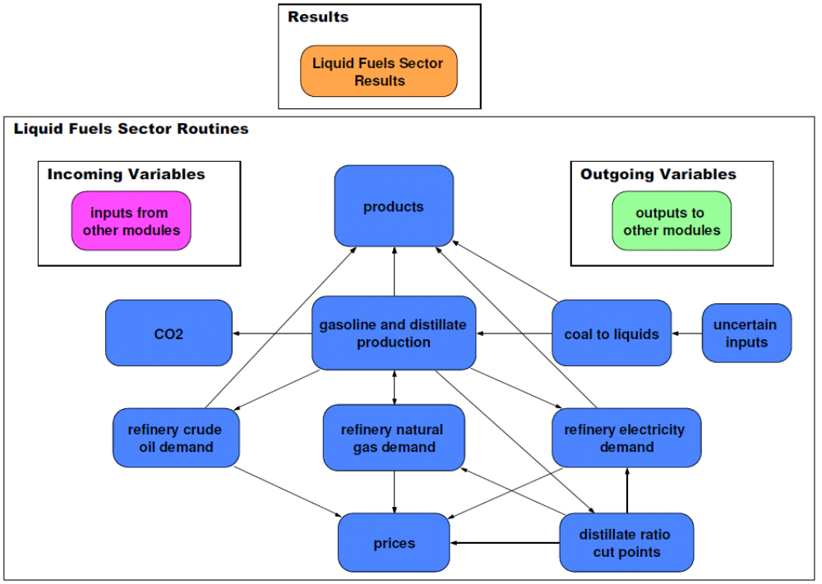
Major Components of Liquid Fuels Sector

Slide 5
Major Components of Liquid Fuels Sector
Petroleum gasoline and distillate production
Gasoline and ethanol blending
Biodiesel blending with middle distillates
Coal to liquids with carbon capture and storage (CCS)
Demands for crude oil, NGL, natural gas, electricity, and coal
Hydrogen production for refinery use
Major product prices

Slide 6
Major Assumptions
Refinery capacity is built to balance anticipated excess demand for diesel and jet fuel with surplus domestic production of gasoline, with differences being sold on the world market.
Process yields and variable inputs (e.g. hydrogen for hydroprocessing) are based on the (Macro Analysis of Refining Systems) MARS model, specified by Dr. John Marano, refinery consultant

Slide 7
Decision Flow in Liquid Fuels Sector
Coal-to-Liquids
(CTL)
Biodiesel
Fuel Demands from End-Use Sectors
Crude Oil Demand
Crude Oil Price
Refinery Energy Use
Natural Gas Demand
Natural Gas Price
Electricity Demand
Electricity Price
pure gasoline price
Fuel Prices:
Diesel, Gasoline, E85, Light FO
Ethanol Capacity and Price
Ethanol-Gasoline Blending
Inputs
Outputs

Slide 8
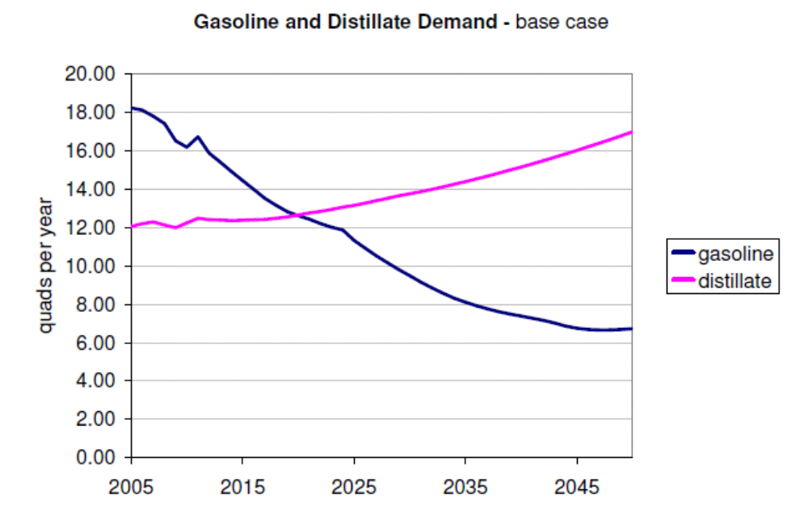
Gasoline and Distillate Production
Gasoline:
  Motor Gasoline,
  Aviation Gasoline
Distillate:
  Diesel
  Jet Fuel
  Light Fuel Oil
Relative proportion of refinery gasoline and distillate can only be changed by about 10% in existing refineries
  cut points can only be changed slightly
  more distillate can be made by hydrocracking,
    natural gas intensive, increased capital cost.

Slide 9
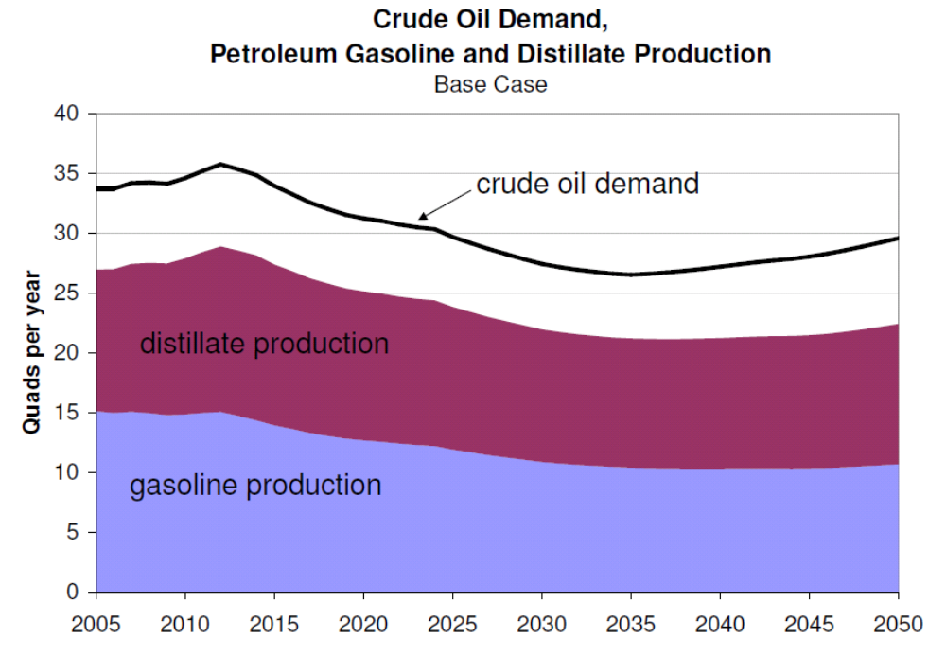
Crude Oil Demand
Yields based on MARS model runs

Slide 10
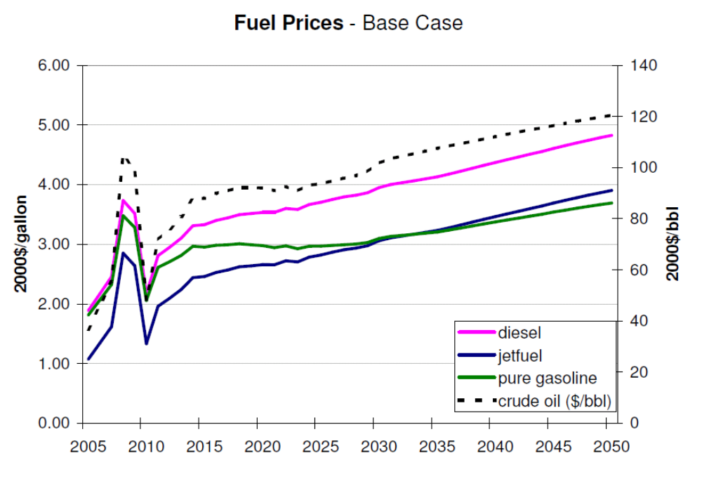
Prices
Determine end-use fuel prices by solving:
  total joint costs = total joint revenues
  costs: crude oil, natural gas, electricity, profit
  major revenues: gasoline, diesel, jet fuel
  this is the economic condition necessary for further investment
Add markup: tax and distribution costs

Slide 11
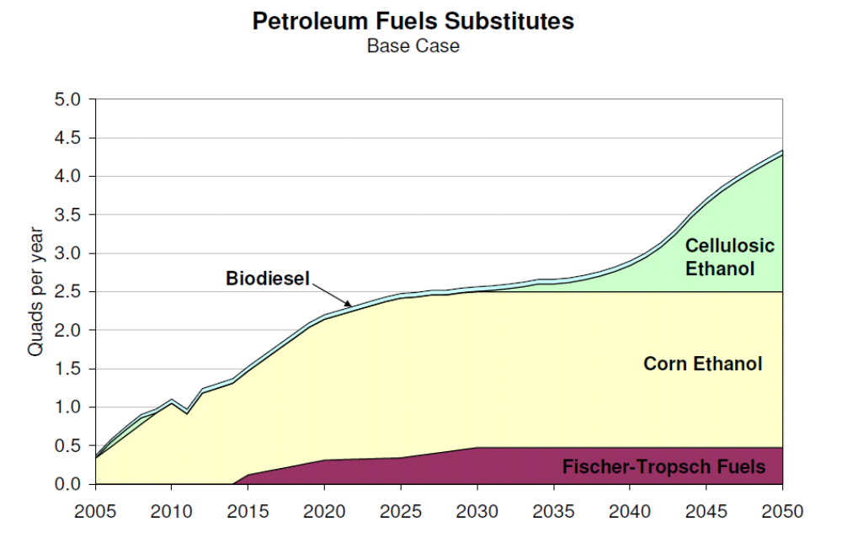
Petroleum Fuel Substitutes
Ethanol – gasoline substitute
  Corn ethanol: currently exogenously specified in LF module
  Cellulosic ethanol: from Biofuels module
Biodiesel (currently exogenous) – diesel substitute
FT liquids – gasoline and diesel substitutes

Slide 12
Ethanol-Gasoline Blending Algorithm
Fuel Demand Inputs:
Non Flex Fuel Vehicles (gasoline)
Flex Fuel Vehicles (gasoline or E85)
Min Ethanol
Flexible Fuel
(fuel that can be gasoline or ethanol)
Ethanol Allocation:
Max out conv. gasoline ethanol requirements,
Then apply to E85.
Gasoline
Percent Ethanol Requirements:
Conventional Gasoline (4.7%-6.8%)
E85 (74.3%)
Ethanol
Demand Outputs:
E85
Conv. Gasoline
Ethanol Supply Capacity:
Cellulosic Ethanol
Corn Ethanol
Capacity Constrained Logit
Min Ethanol – 2 competing fuels (corn & cellulosic)
Flexible – 3 competing fuels (corn, cellulosic, & gasoline)
Price Inputs:
Gasoline
Cellulosic Ethanol
Corn Ethanol
Price Outputs:
E85 Price
Conv. Gasoline Price
Ethanol Price
Feedback to biofuels module - when to build more cellulosic ethanol capacity.

Slide 13
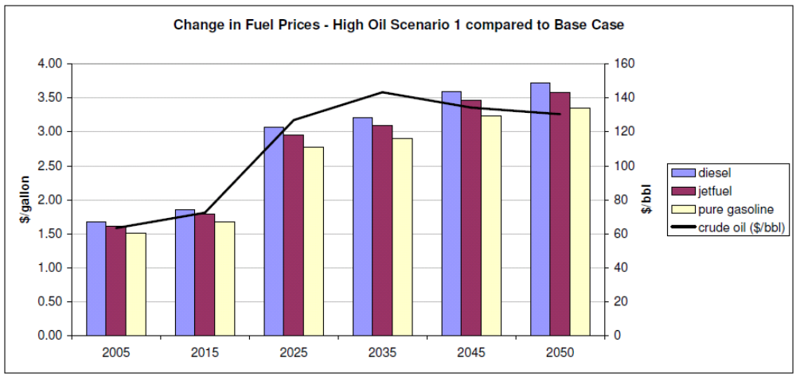
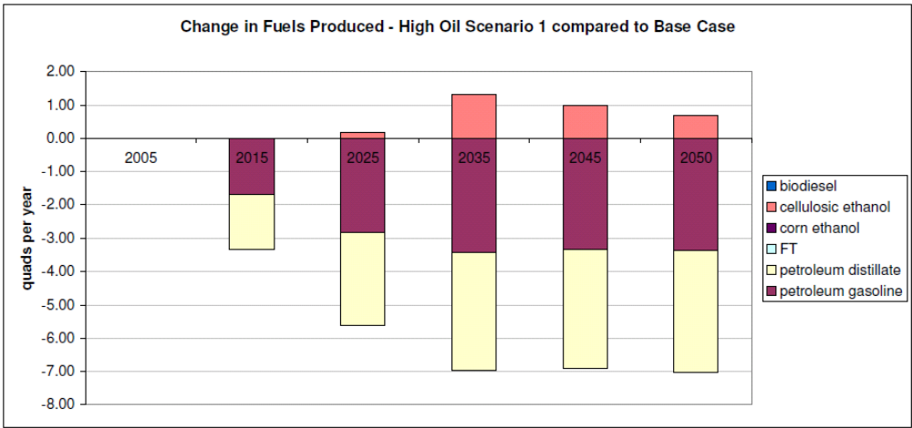
High Oil Scenario Compared to Base
Change in fuel prices
High Oil Scenario: Oil price increase to $250/bbl in 2030 then constant.
Change in fuels produced

Slide 14
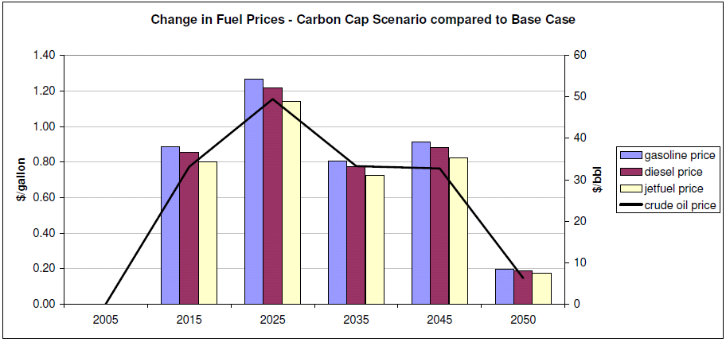
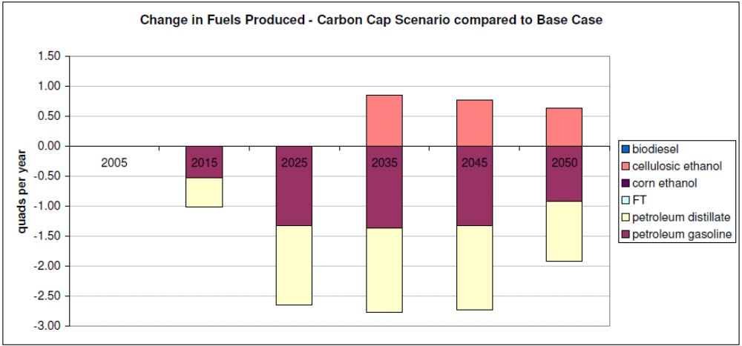
Carbon Cap Scenario Compared to Base
Change in fuel prices
Change in fuels produced

Slide 15
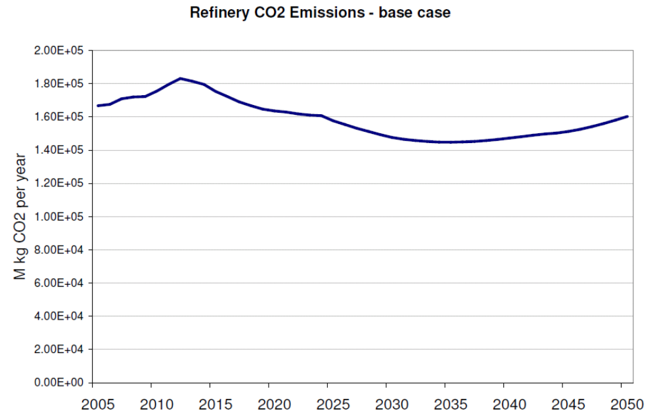
Resulting Refinery CO2 Emissions

Slide 16
The MARS Model (co-author John Marano) is response basis
Field Butanes
LPG
n-Butane
SGP
SFA
G
a
s
o
P
o
o
l
Purchased
Ethanol
Natural
Gasoline
I4O
UGP
ALK
ISO
ISO
LSR
Prm Gasoline
LSR/DHO/HCL
A
C
U
NHT
D
H
X
Reg Gasoline
HSR
H2
RFT
LPR
SRK
HTK
D
i
s
t
P
o
o
l
KHT
SRD
DHT
HTD
Kerosene
(Jet Fuel)
Crude Oil
SRD
AGO
GHT
CCU
CCLN/CCHN
ARC
V
C
U
GDS
Diesel
HTCN
HCK
HCK
VGO
DFO
H2
HCD
ARD
NGS,RGS
SMR
NGS,RGS
PFS
VRC
CSO
RFO
Asphalt
DLC
GSF
H2
H2S
SRU
Sulfur
Petcoke
Notes:
Process Units:
Process Streams:
NOMENCLATURE:

Slide 17
Sources of Data
EIA Petroleum Supply Annual
EIA Refinery Capacity Report
NEMS Petroleum Market Model Documentation and Business-as-Usual PMM Model Run Results
NETL Baseline Technology Report, 2007
NETL Refining & End Use Study (1995)
OIT Energy & Environmental Profile of The U.S. Petroleum Refining Industry (1998)
Petroleum Refining 3rd-Ed., Gary & Handwerk (1994)
BP Statistical Review of World Energy, June 2008
John Marano, MARS DataBook, 2006

Slide 18
Stochastic Variables – existing and proposed future work
Costs and penetration of Coal-to-Liquid coproduction plants (with comparison to IGCC, or power plant retrofits, with CCS)
Development, costs, and penetration of CCS by refineries (e.g. pet coke, coal, and slurry oil gasification with CO₂ capture) and by crude oil and natural gas producers
Possibility of demonstration plants to accelerate transitions to low-carbon technologies
Include uncertain impacts of Rest of World growth on fuels markets

Slide 19
Other Future Work
Expand other refinery products (MARS model includes 11 major petroleum product groups)
Impacts of crude quality degradation (e.g., expanded use of syncrude produced from Canadian oil sands)
Integrate Bio Oils into SEDS LF’s module (based on John Marano’s MARS representation)
Incorporate regional distribution of refinery capacity and access to crude oil and bio oil by shipping or pipelines
Provide key liquid-fuels-related macro variables: investment outlays, crude oil import shares and expenditures, product price impacts

